Slide 1
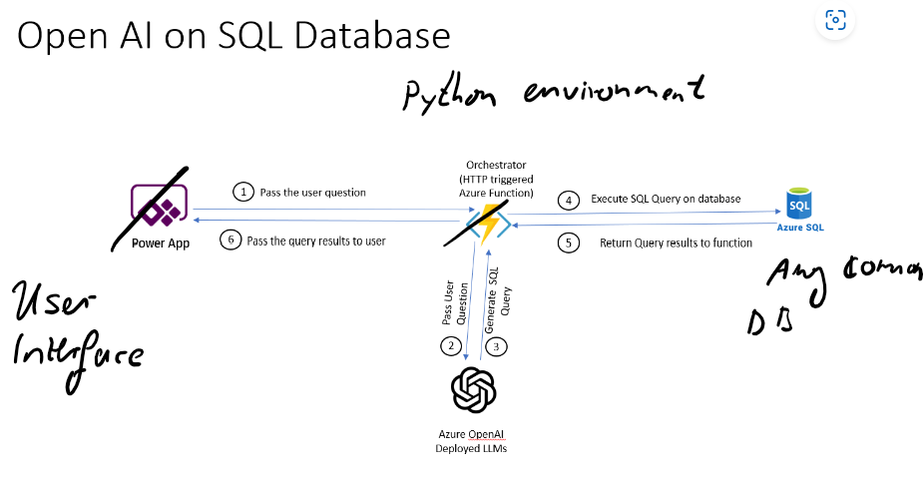
Basic Idea of how to connect openAI and SQL DB

Slide 2
Data cleaning, column renaming
Initialize connection to DB
Get list of tables and columns from system tables ( can be customized to filter to specific tables )
Show system prompts
Explain some logic of follow up checks of SQL results
Output
User Interface allows to change between different styles (select, analyse, insert), but could also connect to different data bases (with code adjustments)

Slide 3
Detailed architecture ( and features that be individually changed)

Slide 4
Chain of thought and ReAct, basic theory
(maybe I, Elisabeth, do this slide…)

Slide 5
Slide on analysis section, example what chain of thought can achieve

Slide 6
Slide on insert statements, experimentell
Use cases
Changed system message
Staging tables
Challenges, limitations

